Slide 1

Data Science For Business
January 2025
Module 2 – Supervised Segmentation

Slide 2
Syllabus Reminder
ChatGPT
Late penalty
Participation

Slide 3
EV[Decision] >= EV[Not Decision]

Slide 4
Quiz time!

Slide 5
Quiz discussion!

Slide 6
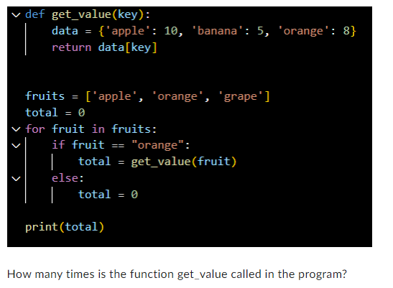
Q1
0
1
2
3

Slide 7
Q1
0
1
2
3

Slide 8
Agenda
Week 1
Module 1 (Thursday): Intro to data science + Python for DS
Module 2 (Friday): Intro to supervised learning
Week 2
Module 3 (Monday): Fitting models, generalization
Module 4 (Tuesday): Regularization
Module 5 (Wednesday): Evaluation (ROC, cost visualization)
Module 6 (Thursday): Modeling text data
Week 3
Module 7 (Monday): Neural networks, GenAI
Module 8 (Tuesday): Guest lecture(s)
Module 9 (Wednesday): Causal inference, AB testing, wrap up
Final Exam (Thursday)

Slide 9
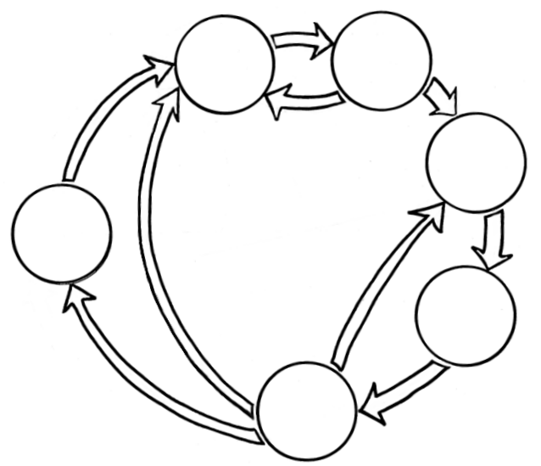

Where we are
Business Understanding
Data Understanding
Data Preparation
Data Science
Process
Deployment
Modeling
Evaluation

Slide 10
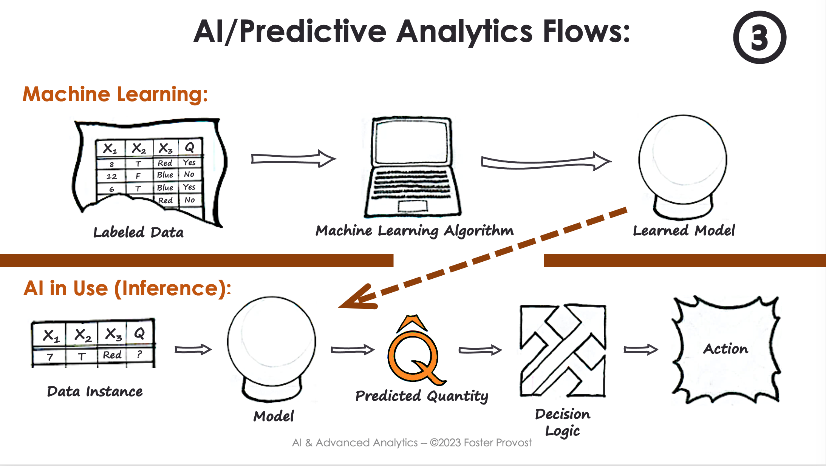

Where we are

